Slide 1
Data Mesh Reference Implementation
Example Case 3 – Iteration 1
Operationalization and Networks
Centre for Data Management, Innovation and Analytics
Corporate Data and Surveillance Branch
Public Health Agency of Canada

Slide 2
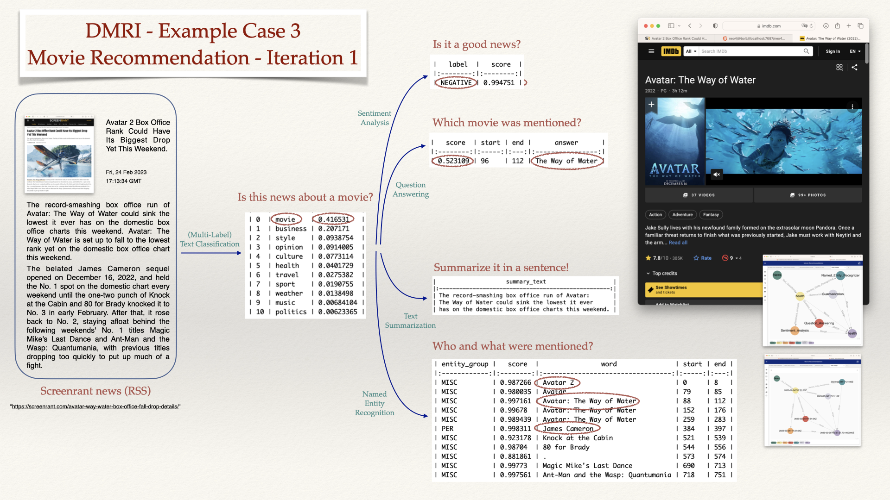

Slide 3
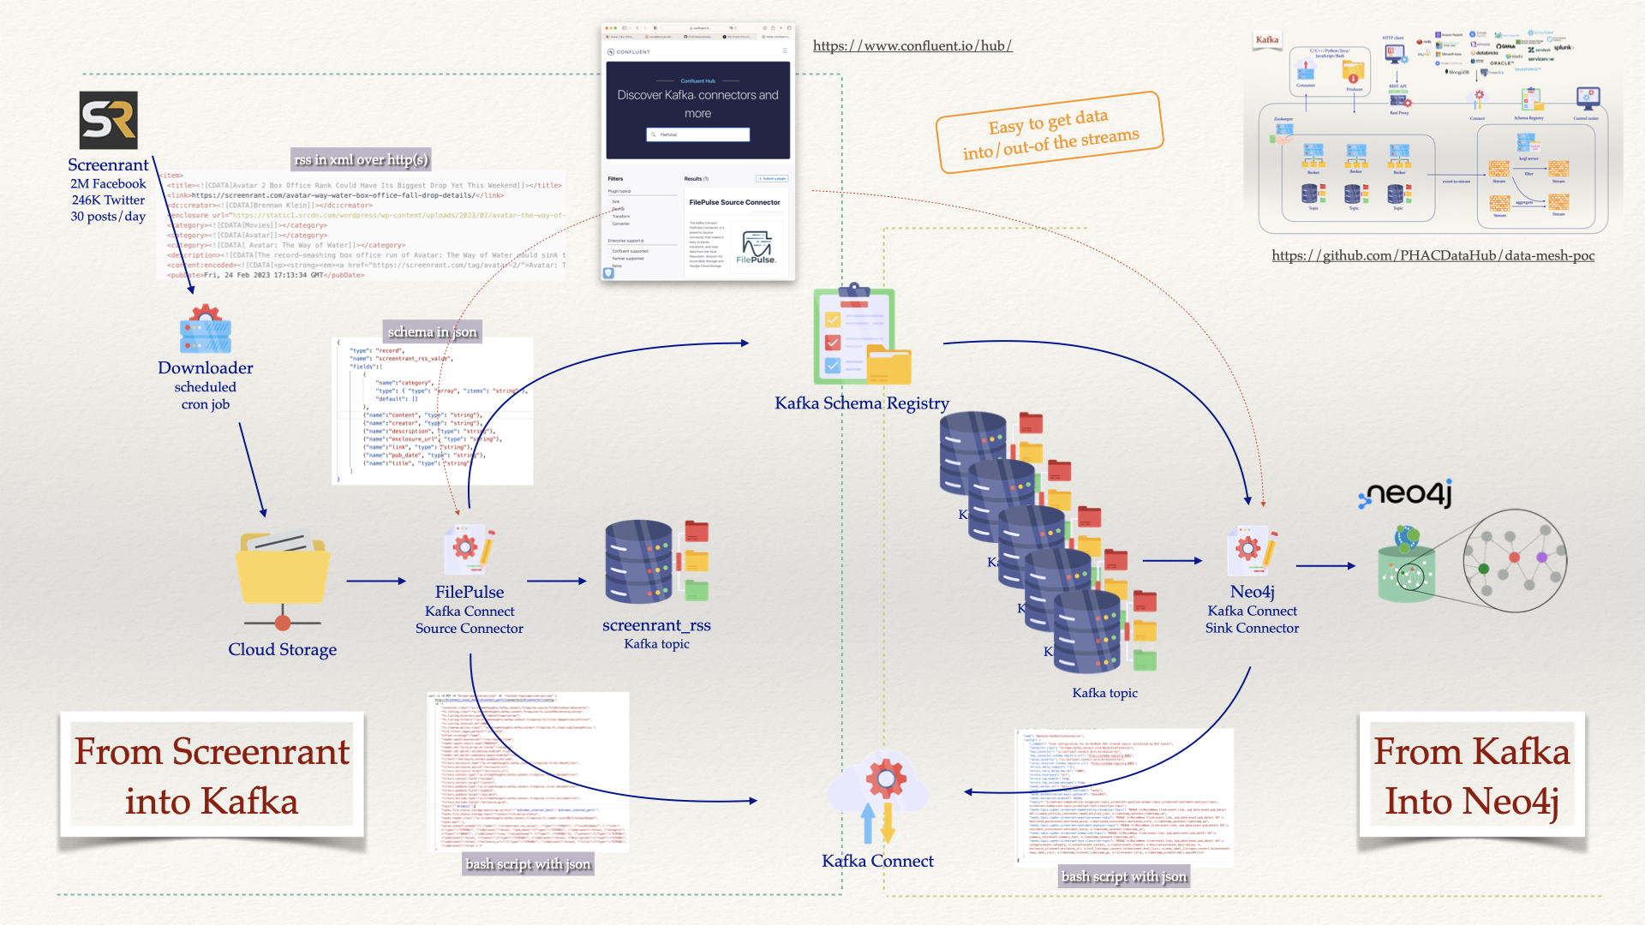

Slide 4
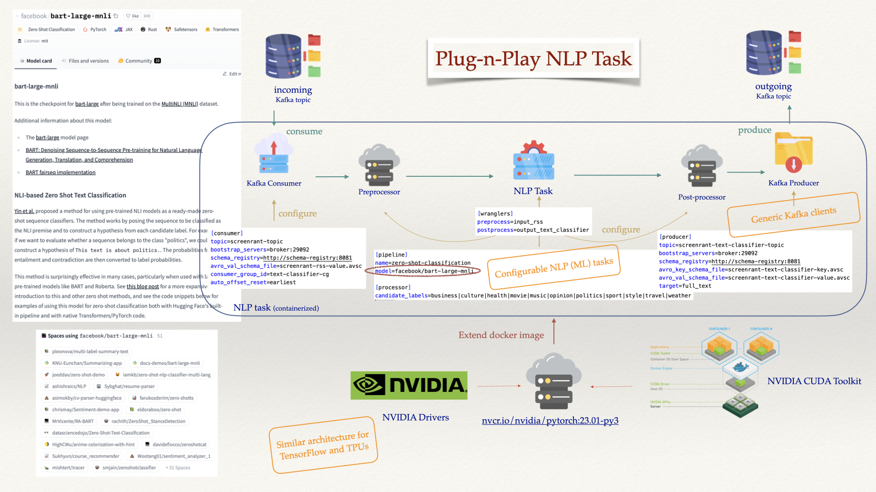

Slide 5
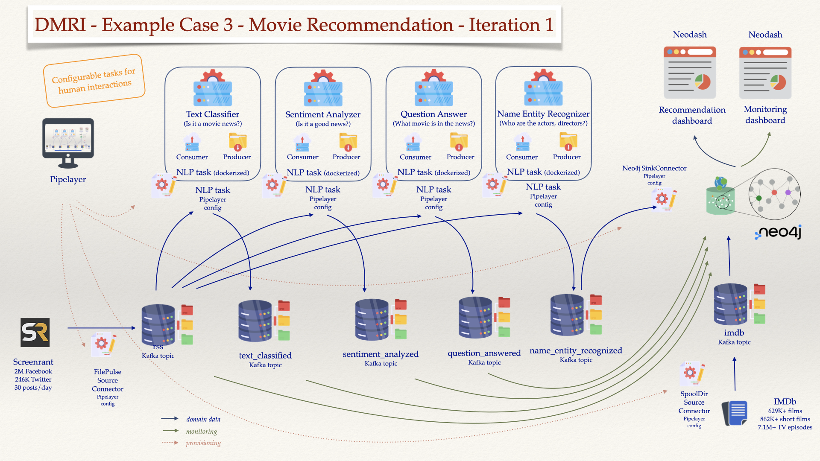

Slide 6
